Slide 1
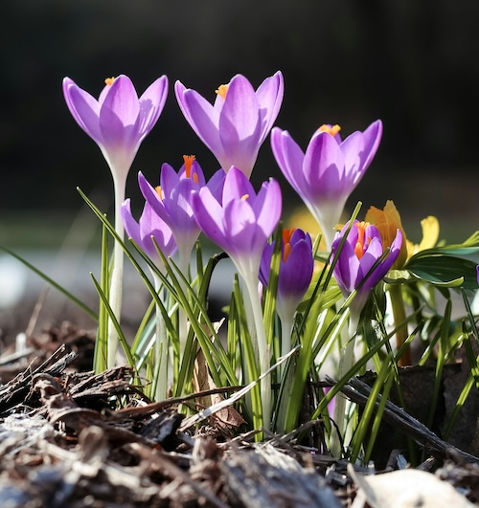
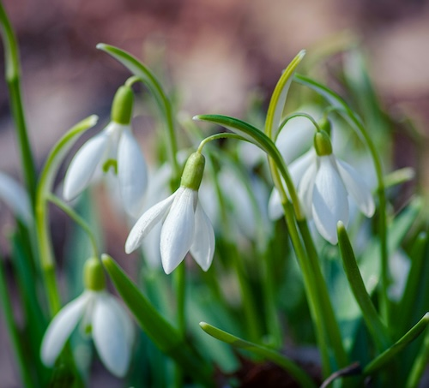
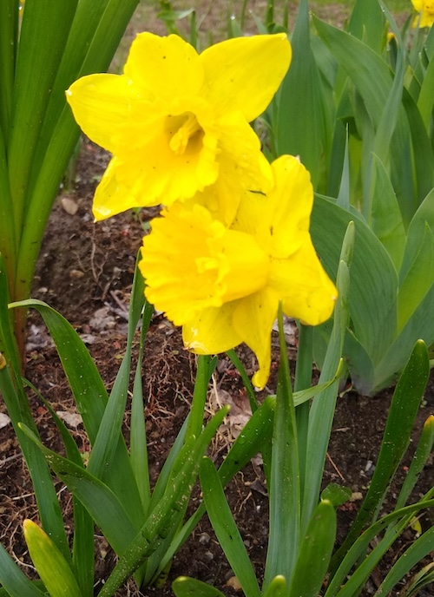
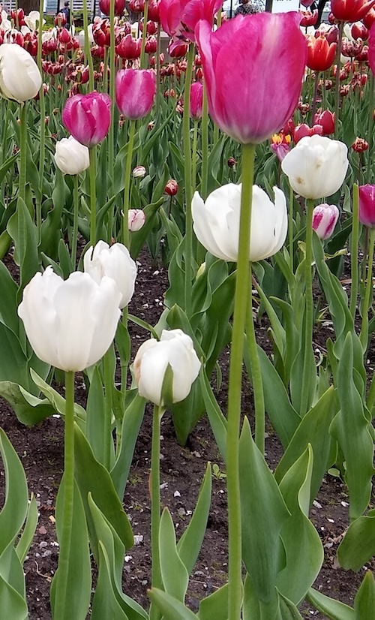
Spring Gap Fill Poem
This resource includes:
Teacher Assessment Guide
Lesson Plan Ideas (in “speaker notes”)
Language focus: adjectives
Visit https://kimtharrison.ca/2024/04/28/spring-gap-fill-poem-k-2/ for: printable PDF / Google Slides versions
Grades K-2
ELL, Grade 3
ESL, Elementary
(all ages)

Slide 2
A.) Matching
Match the pictures below with the flower names:
tulip
crocus
snowdrop
daffodil
Notes:
From left: crocus, snowdrops, daffodils, tulips

Slide 3
B.) Choosing correct response/brainstorming
Which of these adjectives can we use to describe spring flowers?
happy
dark
bright
grey
sad
cheerful
cheery
fragrant
stinky
What other adjectives can we use to describe spring flowers?
Notes:
Adjectives: words that describe a noun. Prompt as needed: What colour is the crocus? The daffodil? The crocus is purple OR a purple crocus (purple = adjective)
Various answers: happy, bright, cheery, cheerful, fragrant
If SS are not familiar with any of the words, prompt as needed: is this flower stinky or fragrant (can mime both / use facial expressions to help SS see the difference); is the flower cheerful or sad?
Ask SS to offer other adjectives, and prompt as needed. Try to find 3 or more words. (suggestions: colourful, joyful, smiley, glad, shiny, sparkly, light)

Slide 4
C.) Fill in the gaps
Fill in the gaps in this poem by choosing the best word, then choosing your own words.
Crocus flowers reach for the sun,
bright and cheery,
so much _____________
Crocus flowers wave to the bees,
warm and fragrant,
in the ________________
Crocus flowers _____________,
________ and _________
__________________
done
fun
breeze
knees
Notes:
Stanza 1: fun
Stanza 2: breeze
Stanza 3: various answers.
If Stanza 3 is too difficult for SS, prompt as needed. Mime “reach for the sun”, then “wave to the bees”, then ask: what else do flowers do in spring? Encourage SS to find a verb + complement (”reach” + “for the sun” “wave” + “to the bees”)
Then, prompt adjectives as needed (show adjectives SS brainstormed during previous slide exercise)

Slide 5
Teacher Assessment Checklist:
Look for:
Did the student? | Yes/No
A.) Participate
B.) Choose 2 or more correct answers and/or suggest further adjectives
C.) Choose correct words for Stanza 1 and 2
C.) Use their imagination for Stanza 3
C.) Complete all the gaps
Notes:
If you need to assess SS when using this resource.

Slide 6
Copyright & Terms of Use
All text and images in this resource, including any originals poems, are copyright © Kim T. Harrison, 2024, unless noted below.
Fonts credit: Google Fonts (Urbanist; Caveat)
Photo of crocus: Photo by Jessica Fadel on Unsplash
Photo of snowdrops: Photo by Yoksel 🌿 Zok on Unsplash
You have permission to use and adapt this resource for educational purposes only.
Any re-selling is prohibited; similarly, re-sharing without attribution is prohibited.
If sharing this resource with other educators, please include link to my website: kimtharrison.ca and/or my full name, Kim T. Harrison
If you have questions or would like to provide feedback on the resource, please get in touch: kimtharrisonwrites@gmail.com
Happy teaching!
Kim xo

Slide 7

About the Resource Creator
Kim T. Harrison is a certified ESL Instructor with a PhD in contemporary French literature and cultural studies. She has been teaching English and French language and literature since 1996 in a variety of settings, including universities, language schools, and around her kitchen table. In recent years, she has also transitioned to teaching online using digital tools.
In addition to her teaching experience, Kim worked for over 15 years in the field of corporate communications and copywriting.
Kim loves the possibilities of language in all its forms and today finds joy in teaching languages, writing her own stories and poems, and creating resources to inspire students, teachers, and fellow writers. Kim currently lives on the beautiful Avalon Peninsula in Newfoundland, Canada, with her family.
I hope you find this resource useful. If you have any questions or have ideas for other resources, please get in touch! Kim kimtharrisonwrites@gmail.com

