Slide 1
In the corner… poem
Grade 2
ELL, Grade 3
ESL, Elementary

Slide 2
Pre-Reading Questions
The title of the poem is “In the corner…” What do you think the poem will be about? Why do you think that?
What kinds of shapes have corners?
Are there any corners in your school? What other places or rooms have corners?

Slide 3
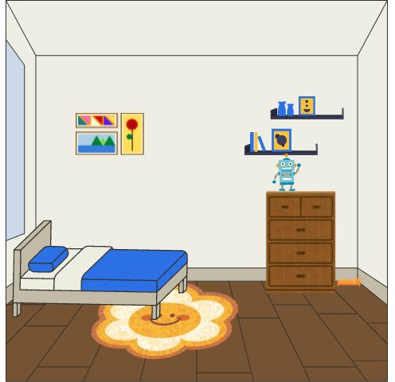


In the corner of my room
Lies a tiny bed
And snuggled up beneath the sheets
Lies a tiny head
And all around, shining bright
Lies a tiny thread
Because in the corner of my room…
Notes:
Teachers: Pause video and ask SS – What do think lies in the corner of the room?

Slide 4

…Lies my spider, Fred!

Slide 5
Post-Reading Questions
Did you guess it was a spider? Why? Why not?
What clues are there in the poem that a spider lies in the corner?
Would you ever have a pet spider? Why? Why not?

Slide 6
Post-Reading Activities: 1
Draw your room using 2D shapes (for example: rectangle, square, triangle, circle).
Then, use shapes to draw an animal, an insect, or an arachnid in the corner!
Notes:
Teachers: Download the PDF version of the lesson resource for printable worksheets for each post-reading activity

Slide 7
Post-Reading Activities: 2
Make your own poem. Use the template below:
In the corner of my room
Lies _________
And snuggled up beneath the sheets
Lies _________
And all around, shining bright
Lies _________
Because in the corner of my room
Lies ____________

Slide 8
Post-Reading Activities: 3
Draw a 3 x 3 grid. Inside each square put the name of a species of spider and draw it.
Or, put the name of a different animal species in each square and draw the animal.

Slide 9
Copyright & Terms of Use
All text and images in this resource, including any original poems, are copyright © Kim T. Harrison, 2024
Fonts credit: Google Fonts (Urbanist; Caveat). Bedroom image created using Canva elements. Spider and thread: created by © Kim T. Harrison using Procreate.
You have permission to use and adapt this resource for educational purposes only.
Any re-selling is prohibited; similarly, re-sharing without attribution is prohibited.
If sharing this resource with other educators, please include link to my website: kimtharrison.ca and/or my full name, Kim T. Harrison
If you have questions or would like to provide feedback on the resource, please get in touch: kimtharrisonwrites@gmail.com
Happy teaching!
Kim xo

Slide 10

About the Resource Creator
Kim T. Harrison is a certified ESL Instructor with a PhD in contemporary French literature and cultural studies. She has been teaching English and French language and literature since 1996 in a variety of settings, including universities, language schools, and around her kitchen table. In recent years, she has also transitioned to teaching online using digital tools.
In addition to her teaching experience, Kim worked for over 15 years in the field of corporate communications and copywriting.
Kim loves the possibilities of language in all its forms and today finds joy in teaching languages, writing her own stories and poems, and creating resources to inspire students, teachers, and fellow writers. Kim currently lives on the beautiful Avalon Peninsula in Newfoundland, Canada, with her family.
I hope you find this resource useful. If you have any questions or have ideas for other resources, please get in touch! Kim kimtharrisonwrites@gmail.com

