Slide 1
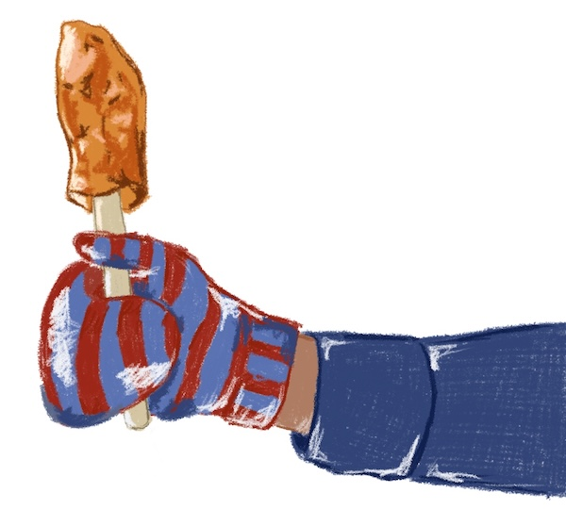
Winter Fun Poem
Grades K-2
ELL, Grade 3
ESL, Elementary

Slide 2
Please pass me that carrot
To use as a nose
Now my snowman’s all done
From his head to his toes
Please pass me that shovel
To use for a door
Now my snow fort’s all done
From the roof to the floor
Please pass me that saucer
To use on the hill
Now my sledding’s all done
From the slide to the thrill
Please pass me that syrup
To use on the snow
Now my taffy’s all done
From the stick to the glow
Please pass me that blanket
To use on my sled
Now my day is all done
And I’m ready for bed

Slide 3
Copyright & Terms of Use
All text and images in this resource, including any original poems or stories, are copyright © Kim T. Harrison, 2025
Fonts credit: Google Fonts (Urbanist; Caveat)
You have permission to use and adapt this resource for educational purposes only.
Any re-selling is prohibited; similarly, re-sharing without attribution is prohibited.
If sharing this resource with other educators, please include link to my website: kimtharrison.ca and/or my full name, Kim T. Harrison
If you have questions or would like to provide feedback on the resource, please get in touch: kimtharrisonwrites@gmail.com
Happy teaching!
Kim xo

Slide 4

About the Resource Creator
Kim T. Harrison is a certified ESL Instructor with a PhD in contemporary French literature and cultural studies. She has been teaching English and French language and literature since 1996 in a variety of settings, including universities, language schools, and around her kitchen table. In recent years, she has also transitioned to teaching online using digital tools.
In addition to her teaching experience, Kim worked for over 15 years in the field of corporate communications and copywriting.
Kim loves the possibilities of language in all its forms and today finds joy in teaching languages, writing her own stories and poems, and creating resources to inspire students, teachers, and fellow writers. Kim currently lives on the beautiful Avalon Peninsula in Newfoundland, Canada, with her family.
I hope you find this resource useful. If you have any questions or have ideas for other resources, please get in touch! Kim kimtharrisonwrites@gmail.com

