Slide 1

What Am I?
Spring Riddle Poem
By Kim T. Harrison
Grades 2-4
ELL
ESL, Elementary

Slide 2
Raindrops plop on the slushy snow
It’s time to wake! It’s time to go!
My stripy fur feels warm again
Let’s find a nest! Let’s leave the den!
I zip past squirrel, hear his squeaks
I munch on nuts! I stuff my cheeks!
What Am I?

Slide 3
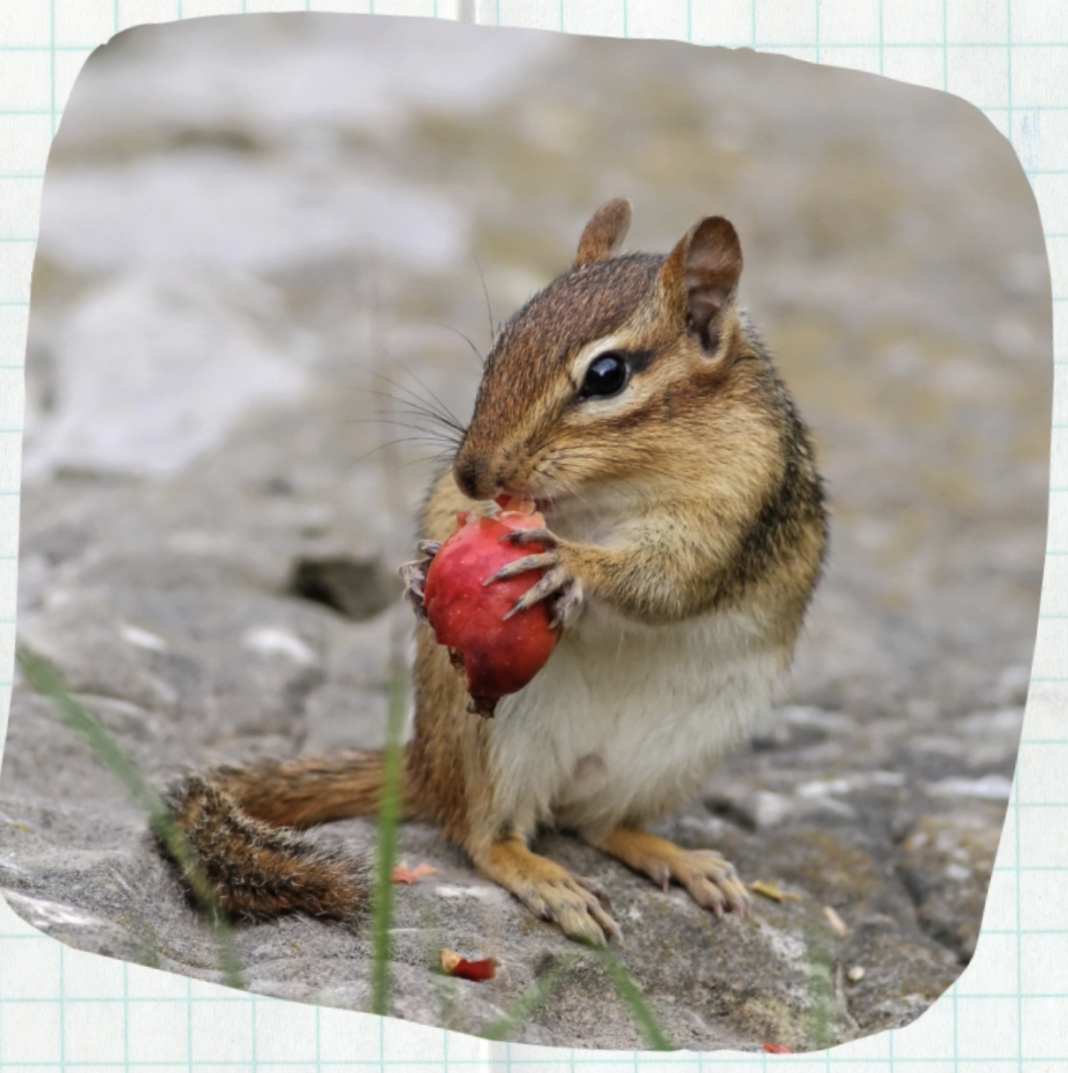
A chipmunk!

Slide 4
Copyright & Terms of Use
All text and illustration in this resource, including any original poems or stories, are copyright © Kim T. Harrison, 2025
Fonts credit: Google Fonts (Urbanist; Caveat)
Image credit: Canva Pro (photograph of squirrel; paper background)
You have permission to use and adapt this resource for educational purposes only.
Any re-selling is prohibited; similarly, re-sharing without attribution is prohibited.
If sharing this resource with other educators, please include link to my website: kimtharrison.ca and/or my full name, Kim T. Harrison
If you have questions or would like to provide feedback on the resource, please get in touch: kimtharrisonwrites@gmail.com
Happy teaching!
Kim xo

Slide 5

About the Resource Creator
Kim T. Harrison creates fun poems that kids will enjoy and teachers will find useful! She is a certified ESL Instructor with a PhD in contemporary French literature and cultural studies. She has been teaching English and French language and literature since 1996 in a variety of settings, including universities, language schools, and around her kitchen table. In recent years, she has also transitioned to teaching online using digital tools.
In addition to her teaching experience, Kim worked for over 15 years in the field of corporate communications and copywriting.
Kim loves the possibilities of language in all its forms and today finds joy in teaching languages, writing her own stories and poems, and creating resources to inspire students, teachers, and fellow writers. Kim currently lives on the beautiful Avalon Peninsula in Newfoundland, Canada, with her family.
I hope you find this resource useful. If you have any questions or have ideas for other resources, please get in touch! Kim kimtharrisonwrites@gmail.com

