Slide 1
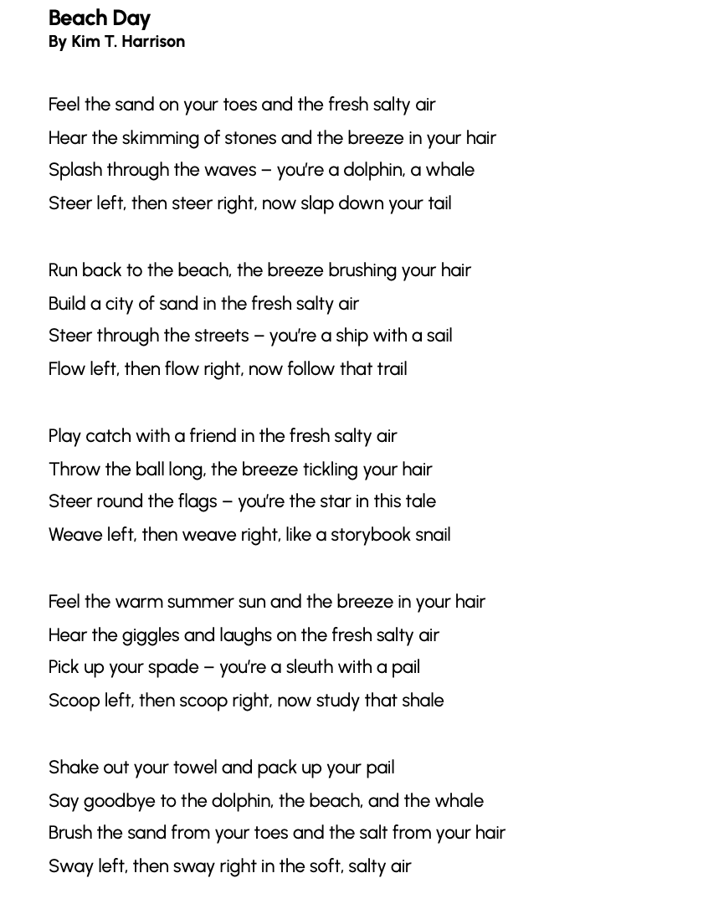
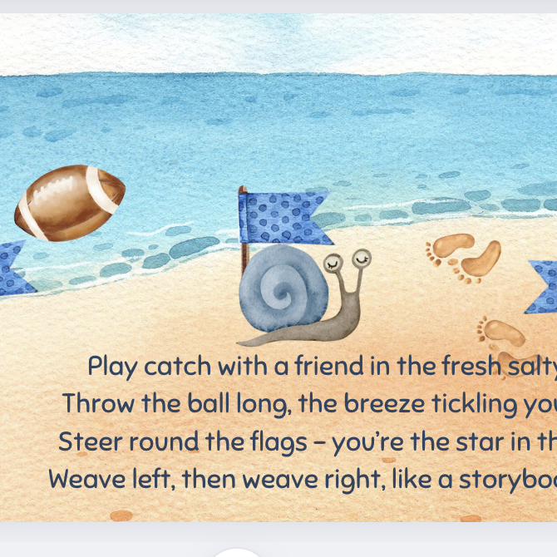

“BEACH DAY” POEM
& ACTIVITY IDEAS
Grades 2-4
ESL, ELL
Original poem by Kim T. Harrison

Slide 2
Feel the sand on your toes and the fresh salty air
Hear the skimming of stones and the breeze in your hair
Splash through the waves – you’re a dolphin, a whale
Steer left, then steer right, now slap down your tail
Run back to the beach, the breeze brushing your hair
Build a city of sand in the fresh salty air
Steer through the streets – you’re a ship with a sail
Flow left, then flow right, now follow that trail
Play catch with a friend in the fresh salty air
Throw the ball long, the breeze tickling your hair
Steer round the flags – you’re the star in this tale
Weave left, then weave right, like a storybook snail
Feel the warm summer sun and the breeze in your hair
Hear the giggles and laughs on the fresh salty air
Pick up your spade – you’re a sleuth with a pail
Scoop left, then scoop right, now study that shale
Shake out your towel and pack up your pail
Say goodbye to the dolphin, the beach, and the whale
Brush the sand from your toes and the salt from your hair
Sway left, then sway right, in the soft, salty air

Slide 3
What did you do over the summer vacation?
Write two sentences or a short paragraph about something you did over the summer.
Draw a picture or make a collage about something you did over the summer.

Slide 4
Opinion paragraph writing (option 1)
1. What is the poem “Beach Day” about? Use the chart below to organize your ideas, then write an opinion paragraph saying what you think the poem is about and why. Remember to include words from the poem.
Opinion statement
First reason
First reason support/example: words from the poem
Second reason
Second reason support/example: words from the poem
Conclusion sentence

Slide 5
Poem Interpretation: Opinion paragraph writing assignment (option 2)
1. Do you like the poem “Beach Day”? Why/Why not? Use the chart below to organize your ideas, then write an opinion paragraph saying if you like or dislike the poem and why. Remember to include words from the poem.
Opinion statement
First reason
First reason support/example: words from the poem
Second reason
Second reason support/example: words from the poem
Conclusion sentence

Slide 6
Poetry Writing
1. Write a poem about something you did over the summer. Use the chart below to help plan your poem.
What activity or memory will your poem be about?
How many stanzas will your poem have?
What are 2 action or sensory verbs you can use in your poem?
What do you want the reader to feel or know about this activity or memory?
What is a word or group of words you want to repeat in your poem?

Slide 7
Poetry Reading / Poetic Devices
1. What poetic devices are used in the following lines from the poem:
… air / hair … whale / tail
you’re a dolphin, a whale you’re a ship with a sail
…fresh salty air / fresh salty air / fresh salty air … your hair / your hair / your hair

Slide 8
Poetry Reading / Poetic Devices
1. What poetic devices are used in the following lines from the poem:
… air / hair … whale / tail | rhyme
you’re a dolphin, a whale you’re a ship with a sail | metaphor
…fresh salty air / fresh salty air / fresh salty air … your hair / your hair / your hair | repetition

Slide 9
Poetry Reading / Poetic Devices
1. What other words rhyme with “air”?
2. Can you create another metaphor, similar to “you’re a dolphin, a whale”?
3. If you were writing a poem about a day at the beach, which words would you repeat? Why?

Slide 10
Grammar / English Language
1. What part of speech is the first word in each of these lines?
Feel the sand on your toes and the fresh salty air
Hear the skimming of stones and the breeze in your hair
Splash through the waves – you’re a dolphin, a whale
Steer left, then steer right, now slap down your tail

Slide 11
Grammar / English Language
1. What part of speech is the first word in each of these lines?
ANSWER: verb (imperative mood)
Feel the sand on your toes and the fresh salty air
Hear the skimming of stones and the breeze in your hair
Splash through the waves – you’re a dolphin, a whale
Steer left, then steer right, now slap down your tail
2. What other verbs do you know that describe actions you can do at the beach?

Slide 12

MORE POEMS & ACTIVITIES…
Grab a print-ready, PDF version of the poem along with more teaching ideas and inspiration at KimTHarrison.ca – Teacher Resources
Browse other poems on a variety of curriculum-friendly topics on my website – KimTHarrison.ca – or my YouTube channel: https://www.youtube.com/@KimTHarrison/videos
Poetry Pause with Dr. Kim videos include a short interactive mindfulness introduction before a poem read by me, the poet! Poetry Time with Dr. Kim videos include the poem and a visual narrative.

Slide 13

THANK YOU & HAPPY POETRY TEACHING!
Copyright & Terms of Use
About Dr. Kim
Original poems or stories are copyright © Kim T. Harrison, 2025
Fonts credit: Google Fonts (Urbanist; Caveat)
Additional images and video creation: Canva Pro
You have permission to use this resource for educational purposes only.
Any re-selling is prohibited; similarly, re-sharing without attribution is prohibited.
If sharing this poem or story with other educators, please include link to my website: kimtharrison.ca and/or my full name, Kim T. Harrison
If you have questions, would like to provide feedback, or need a poem about a sleepy snail, please get in touch: kimtharrisonwrites@gmail.com
Dr. Kim’s full name is Kim T. Harrison. She is a writer, poet, and teacher, who was born in England but moved to Canada a long time ago and now lives on the beautiful island of Newfoundland.
Dr. Kim can’t help fix a broken leg or a sore throat, but she can prescribe poetry reading and writing activities! She’s a “doctor” because she has a PhD in French literature and cultural studies. This means she’s read and written about A LOT of books and poems. When she was a kid, her favourite book had lots of different poems in it. She still reads these poems today and now writes her own because she loves the sound and feel of words, and the magic that happens when those words work together to create new worlds.
Find out more at: KimTHarrison.ca

