Slide 1

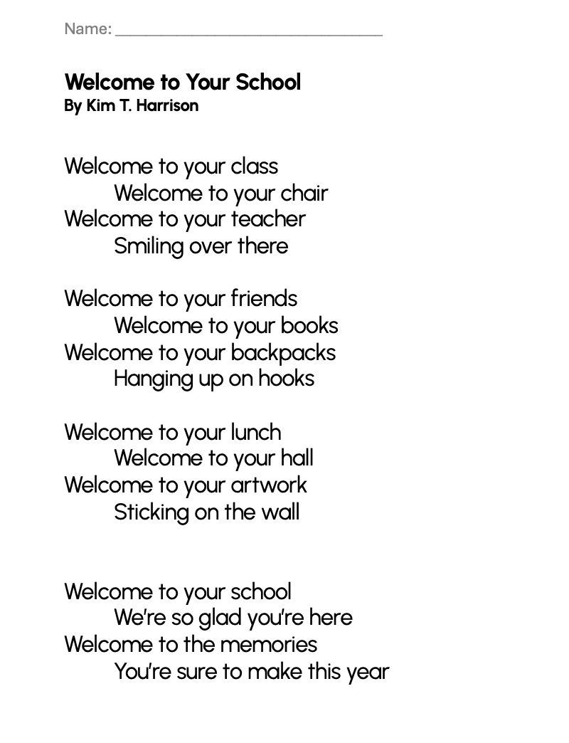
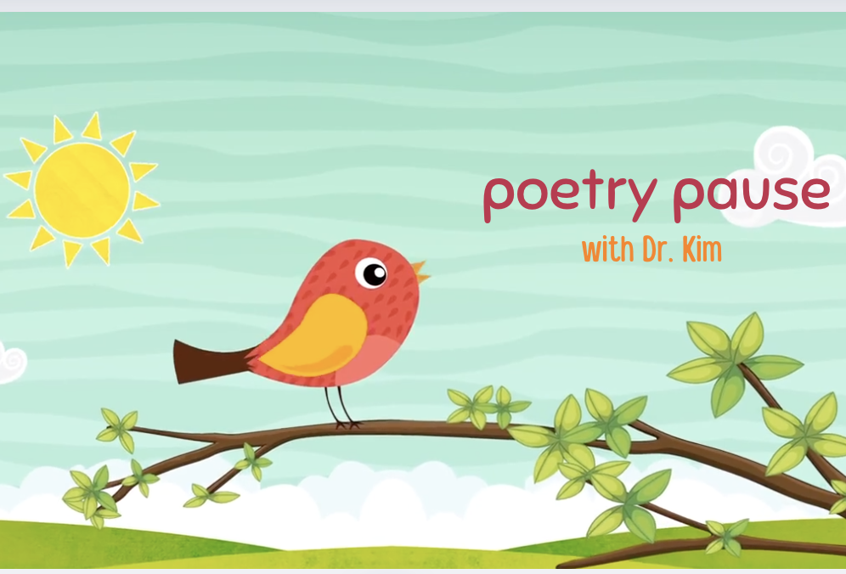
“WELCOME TO YOUR SCHOOL”
POEM
Grades K-2
ESL, ELL
Original poem by Kim T. Harrison

Slide 2
Welcome to Your School
By Kim T. Harrison
Welcome to your class
Welcome to your chair
Welcome to your teacher
Smiling over there
Welcome to your friends
Welcome to your books
Welcome to your backpacks
Hanging up on hooks
Welcome to your lunch
Welcome to your hall
Welcome to your artwork
Sticking on the wall
Welcome to your school
We’re so glad you’re here
Welcome to the memories
You’re sure to make this year

Slide 3
Welcome to Your School
Where is your chair? Where are your books?
Do you have a backpack?
What memories do you think you will make this year?
Draw a picture of your classroom.
Draw a picture of your teacher.

Slide 4

MORE POEMS & ACTIVITIES…
Grab a print-ready, PDF version of the poem along with more teaching ideas and inspiration at KimTHarrison.ca – Teacher Resources
Browse other poems on a variety of curriculum-friendly topics on my website – KimTHarrison.ca – or my YouTube channel: https://www.youtube.com/@KimTHarrison/videos
Poetry Pause with Dr. Kim videos include a short interactive mindfulness introduction before a poem read by me, the poet! Poetry Time with Dr. Kim videos include the poem and a visual narrative.

Slide 5

THANK YOU & HAPPY POETRY TEACHING!
Copyright & Terms of Use
About Dr. Kim
Original poems or stories are copyright © Kim T. Harrison, 2025
Fonts credit: Google Fonts (Urbanist; Caveat)
Additional images and video creation: Canva Pro
You have permission to use this resource for educational purposes only.
Any re-selling is prohibited; similarly, re-sharing without attribution is prohibited.
If sharing this poem or story with other educators, please include link to my website: kimtharrison.ca and/or my full name, Kim T. Harrison
If you have questions, would like to provide feedback, or need a poem about a sleepy snail, please get in touch: kimtharrisonwrites@gmail.com
Dr. Kim’s full name is Kim T. Harrison. She is a writer, poet, and teacher, who was born in England but moved to Canada a long time ago and now lives on the beautiful island of Newfoundland.
Dr. Kim can’t help fix a broken leg or a sore throat, but she can prescribe poetry reading and writing activities! She’s a “doctor” because she has a PhD in French literature and cultural studies. This means she’s read and written about A LOT of books and poems. When she was a kid, her favourite book had lots of different poems in it. She still reads these poems today and now writes her own because she loves the sound and feel of words, and the magic that happens when those words work together to create new worlds.
Find out more at: KimTHarrison.ca

