Slide 1
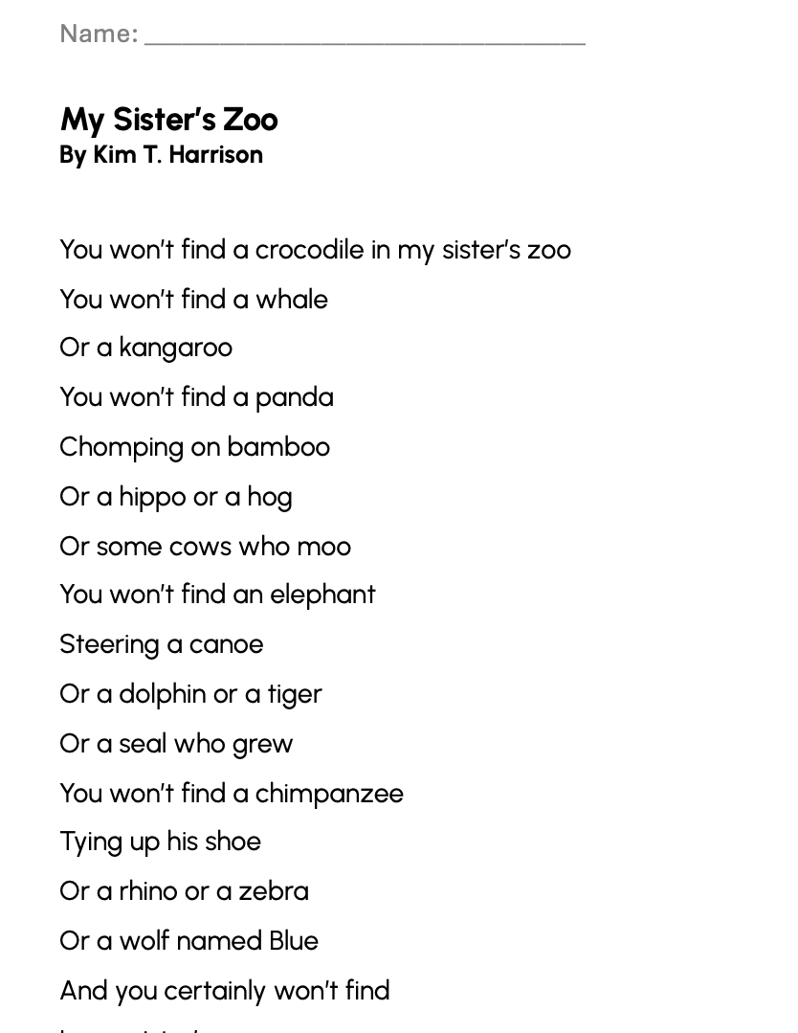
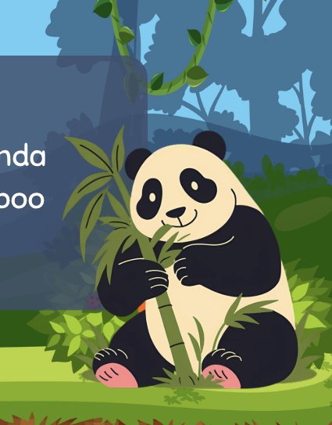
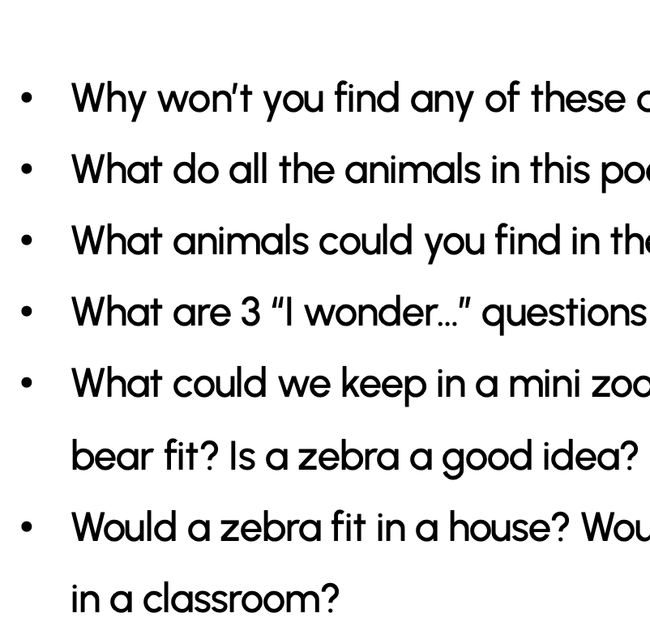
“My Sister’s Zoo” POEM
& ACTIVITIES
Grades 2-3
ESL, ELL
Original poem by Kim T. Harrison

Slide 2
You won’t find a crocodile in my sister’s zoo
You won’t find a whale
Or a kangaroo
You won’t find a panda
Chomping on bamboo
Or a hippo or a hog
Or some cows who moo
You won’t find an elephant
Steering a canoe
Or a dolphin or a tiger
Or a seal who grew
You won’t find a chimpanzee
Tying up his shoe
Or a rhino or a zebra
Or a wolf named Blue
And you certainly won’t find
In my sister’s zoo
All the children in this school
Not them, not me, not you!

Slide 3
QUESTIONS
Why won’t you find any of these animals in the sister’s zoo?
What do all the animals in this poem have in common?
What animals could you find in the sister’s zoo?
What are 3 “I wonder…” questions you could ask about this poem?
What could we keep in a mini zoo in our classroom? Would a polar bear fit? Is a zebra a good idea?
Would a zebra fit in a house? Would it fit in a car? Would a rhino fit in a classroom?

Slide 4
ACTIVITIES
Create a list of other animals that would not fit in a jar.
Create a list of animals that would fit in a jar.
Order the animals in size (height and/or length) and weight.
In pairs, measure each other/yourself and compare the measurement to different animals: Are you taller or shorter than a zebra?
Draw a picture or create a collage of a “zoo in a jar.”

Slide 5
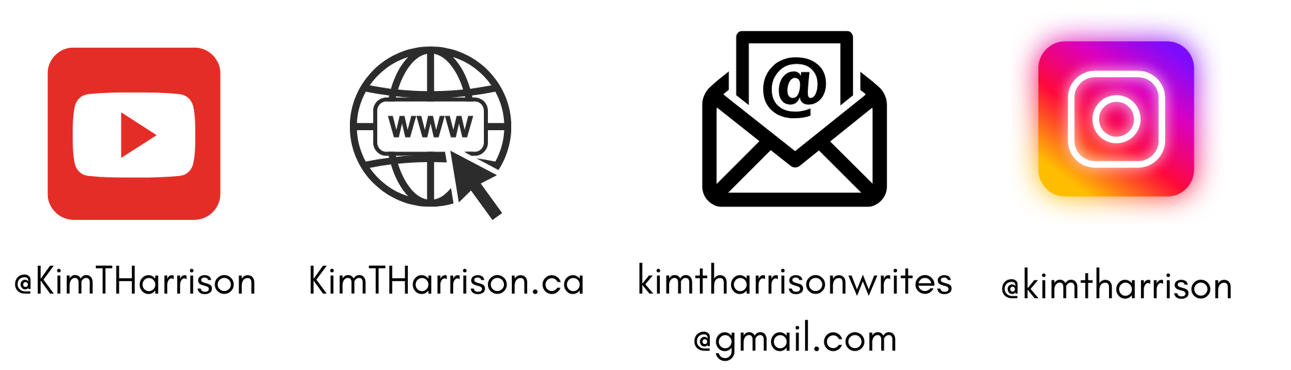
MORE POEMS & ACTIVITIES…
Grab a print-ready, PDF version of the poem along with more teaching ideas and inspiration at KimTHarrison.ca – Teacher Resources
Browse other poems on a variety of curriculum-friendly topics on my website – KimTHarrison.ca – or my YouTube channel: https://www.youtube.com/@KimTHarrison/videos
Poetry Pause with Dr. Kim videos include a short interactive mindfulness introduction before a poem read by me, the poet! Poetry Time with Dr. Kim videos include the poem and a visual narrative.

Slide 6

THANK YOU & HAPPY POETRY TEACHING!
Copyright & Terms of Use
About Dr. Kim
Original poems or stories are copyright © Kim T. Harrison, 2025
Fonts credit: Google Fonts (Urbanist; Caveat)
Additional images and video creation: Canva Pro
You have permission to use this resource for educational purposes only.
Any re-selling is prohibited; similarly, re-sharing without attribution is prohibited.
If sharing this poem or story with other educators, please include link to my website: kimtharrison.ca and/or my full name, Kim T. Harrison
If you have questions, would like to provide feedback, or need a poem about a sleepy snail, please get in touch: kimtharrisonwrites@gmail.com
Dr. Kim’s full name is Kim T. Harrison. She is a writer, poet, and teacher, who was born in England but moved to Canada a long time ago and now lives on the beautiful island of Newfoundland.
Dr. Kim can’t help fix a broken leg or a sore throat, but she can prescribe poetry reading and writing activities! She’s a “doctor” because she has a PhD in French literature and cultural studies. This means she’s read and written about A LOT of books and poems. When she was a kid, her favourite book had lots of different poems in it. She still reads these poems today and now writes her own because she loves the sound and feel of words, and the magic that happens when those words work together to create new worlds.
Find out more at: KimTHarrison.ca

