Slide 1
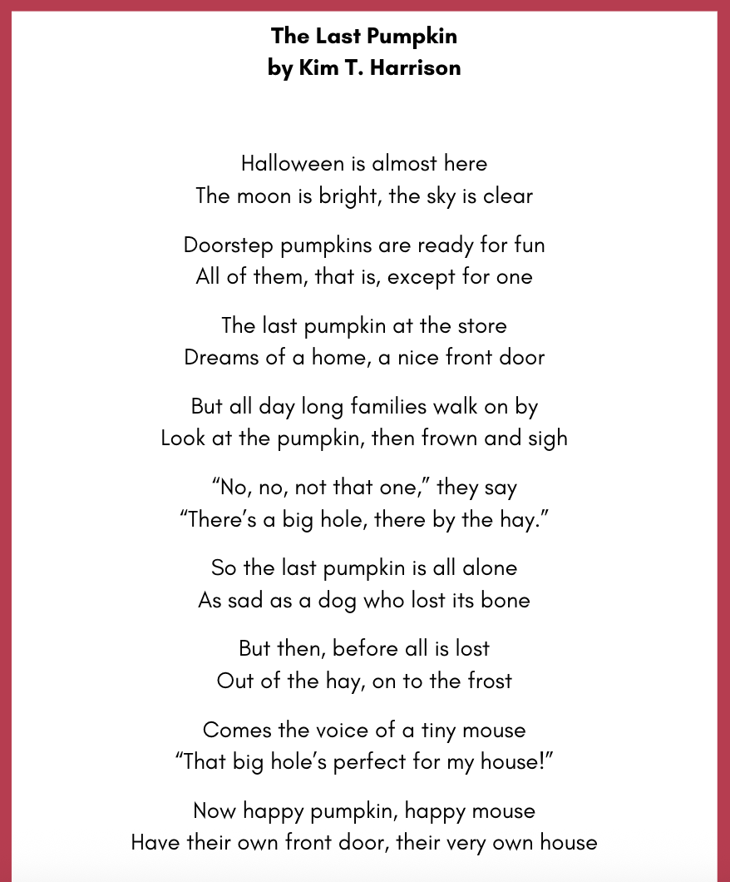
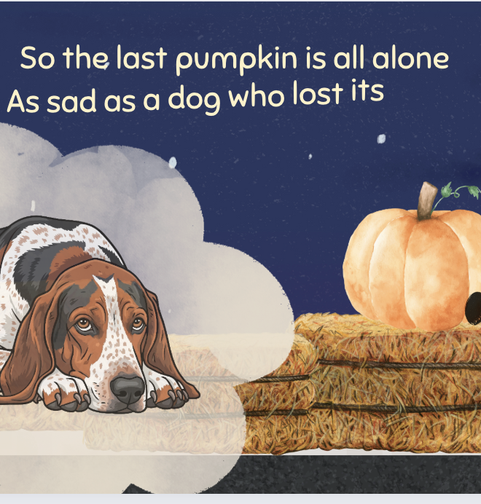

“The Last Pumpkin” POEM
& ACTIVITIES
Grades 1-3
ESL, ELL
Original poem by Kim T. Harrison

Slide 2
Halloween is almost here
The moon is bright, the sky is clear
Doorstep pumpkins are ready for fun
All of them, that is, except for one
The last pumpkin at the store
Dreams of a home, a nice front door
But all day long families walk on by
Look at the pumpkin, then frown and sigh
“No, no, not that one,” they say
“There’s a big hole, there by the hay.”
So the last pumpkin is all alone
As sad as a dog who lost its bone
But then, before all is lost
Out of the hay, on to the frost
Comes the voice of a tiny mouse
“That big hole’s perfect for my house!”
Now happy pumpkin, happy mouse
Have their own front door, their very own house

Slide 3
SEL Questions
Why do families walk on by?
Why do you think the pumpkin is the last in the store?
Would you choose this pumpkin if you saw it?

Slide 4
Halloween Activities
Think about the final two lines of the poem:
Now happy pumpkin, happy mouse
Have their own front door, their very own house
What do you think the “front door” looks like?
What does ”their very own house” look like?
If the pumpkin and mouse decorated their house for Halloween, what would it look like?
TASK:
Draw a picture of the last pumpkin and mouse at Halloween or
Make a collage of the last pumpkin and mouse at Halloween

Slide 5
Math Inquiry Questions & Activities
What 2D shapes can we use to make a picture of a house?
What 3D shapes can we use to make a house out of paper or card?
What shapes do we need to make a net of a 3D house?
What 3D shape is a pumpkin like?
How could we make a 3D pumpkin shape out of paper or card?
Make a 2D or 3D house and decorate it for Halloween
As a whole class, create a full street that is decorated for Halloween. Remember to include the last pumpkin and mouse somewhere!

Slide 6

MORE POEMS & ACTIVITIES…
Grab a print-ready, PDF version of the poem along with more teaching ideas and inspiration at KimTHarrison.ca – Teacher Resources
Browse other poems on a variety of curriculum-friendly topics on my website – KimTHarrison.ca – or my YouTube channel: https://www.youtube.com/@KimTHarrison/videos
Poetry Pause with Dr. Kim videos include a short interactive mindfulness introduction before a poem read by me, the poet! Poetry Time with Dr. Kim videos include the poem and a visual narrative.

Slide 7

THANK YOU & HAPPY POETRY TEACHING!
Copyright & Terms of Use
About Dr. Kim
Original poems or stories are copyright © Kim T. Harrison, 2025
Fonts credit: Google Fonts (Urbanist; Caveat)
Additional images and video creation: Canva Pro
You have permission to use this resource for educational purposes only.
Any re-selling is prohibited; similarly, re-sharing without attribution is prohibited.
If sharing this poem or story with other educators, please include link to my website: kimtharrison.ca and/or my full name, Kim T. Harrison
If you have questions, would like to provide feedback, or need a poem about a sleepy snail, please get in touch: kimtharrisonwrites@gmail.com
Dr. Kim’s full name is Kim T. Harrison. She is a writer, poet, and teacher, who was born in England but moved to Canada a long time ago and now lives on the beautiful island of Newfoundland.
Dr. Kim can’t help fix a broken leg or a sore throat, but she can prescribe poetry reading and writing activities! She’s a “doctor” because she has a PhD in French literature and cultural studies. This means she’s read and written about A LOT of books and poems. When she was a kid, her favourite book had lots of different poems in it. She still reads these poems today and now writes her own because she loves the sound and feel of words, and the magic that happens when those words work together to create new worlds.
Find out more at: KimTHarrison.ca

