Slide 1
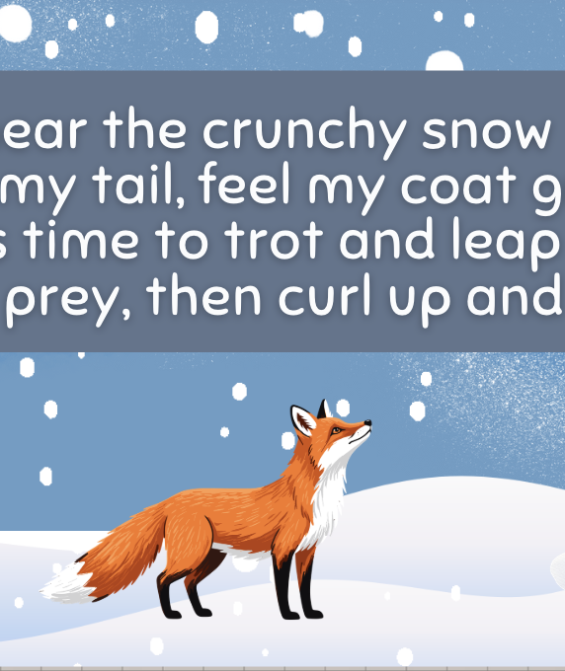
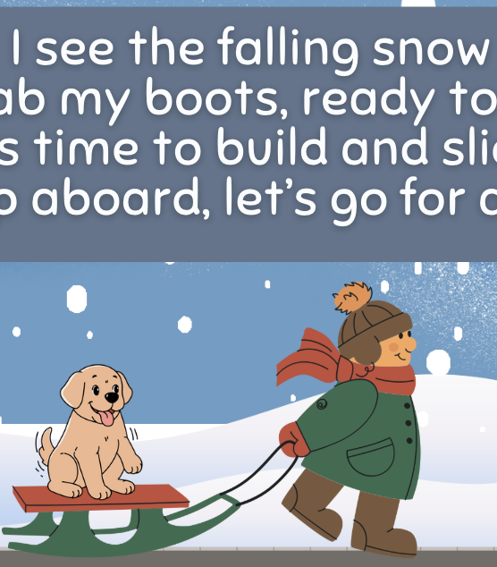
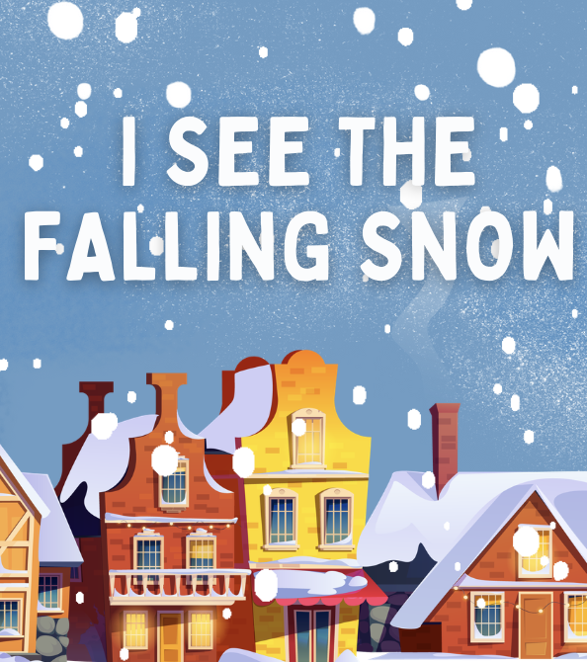
“I See the Falling Snow”
POEM & ACTIVITIES
Grades 1-2
ESL, ELL
Original poem by Kim T. Harrison

Slide 2
I see the falling snow
Grab my boots, ready to go
It’s time to build and slide
Jump aboard, let’s go for a ride
I hear the crunchy snow
Swish my tail, feel my coat grow
It’s time to trot and leap
Hunt for prey, then curl up and sleep
I feel the slushy snow
Store my snacks, buried down low
It’s time to nap and rest
Snuggled up, all safe in my nest
I smell the distant snow
Calm my breath, keep my heart slow
It’s time to hang and roost
Lick the walls to give me a boost
I taste the powdery snow
Watch the sky put on a show
It’s time to yawn and doze
Head inside and warm up my toes

Slide 3
Can you guess who is speaking?
I hear the crunchy snow
Swish my tail, feel my coat grow
It’s time to trot and leap
Hunt for prey, then curl up and sleep

Slide 4
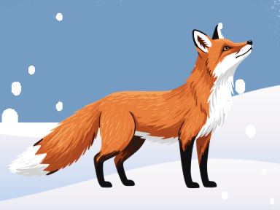
Answer: A red fox
I hear the crunchy snow
Swish my tail, feel my coat grow
It’s time to trot and leap
Hunt for prey, then curl up and sleep

Slide 5
Can you guess who is speaking?
I feel the slushy snow
Store my snacks, buried down low
It’s time to nap and rest
Snuggled up, all safe in my nest

Slide 6
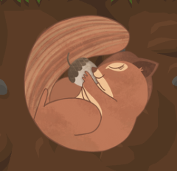
Answer: an Eastern chipmunk
I feel the slushy snow
Store my snacks, buried down low
It’s time to nap and rest
Snuggled up, all safe in my nest

Slide 7
Can you guess who is speaking?
I smell the distant snow
Calm my breath, keep my heart slow
It’s time to hang and roost
Lick the walls to give me a boost

Slide 8
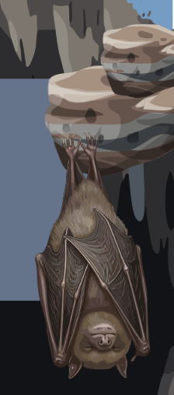
Answer: a little brown bat
I smell the distant snow
Calm my breath, keep my heart slow
It’s time to hang and roost
Lick the walls to give me a boost

Slide 9
Make 3 questions or sentences:
I know … | I wonder …

Slide 10
Make 4 questions about animals in winter.
Do Are
Can
Why
How
Notes:
Teacher notes: prompt as needed. For example: Do red foxes hibernate? Can chipmunks eat in winter?

Slide 11




What does snow smell like?
What does snow taste like?
What does snow look like?
What does snow sound like?

Slide 12
Draw a picture of:
Your neighbourhood in winter
OR
How you play in the snow

Slide 13
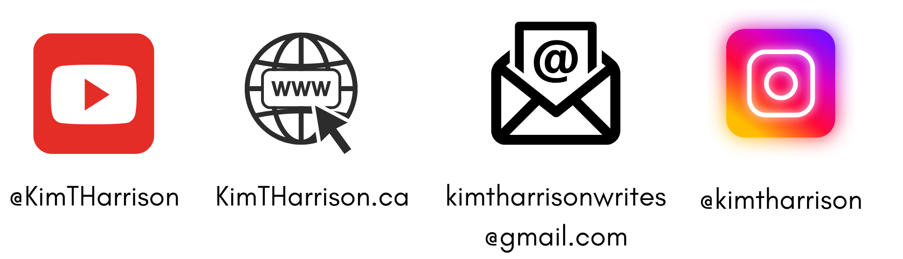
MORE POEMS & ACTIVITIES…
Grab a print-ready, PDF version of the poem along with more teaching ideas and inspiration at KimTHarrison.ca – Teacher Resources
Browse other poems on a variety of curriculum-friendly topics on my website – KimTHarrison.ca – or my YouTube channel: https://www.youtube.com/@KimTHarrison/videos
Poetry Pause with Dr. Kim videos include a short interactive mindfulness introduction before a poem read by me, the poet! Poetry Time with Dr. Kim videos include the poem and a visual narrative.

Slide 14

THANK YOU & HAPPY POETRY TEACHING!
Copyright & Terms of Use
About Dr. Kim
Original poems or stories are copyright © Kim T. Harrison, 2026
Fonts credit: Google Fonts (Urbanist; Caveat)
Additional images and video creation: Canva Pro
You have permission to use this resource for educational purposes only.
Any re-selling is prohibited; similarly, re-sharing without attribution is prohibited.
If sharing this poem or story with other educators, please include link to my website: kimtharrison.ca and/or my full name, Kim T. Harrison
If you have questions, would like to provide feedback, or need a poem about a sleepy snail, please get in touch: kimtharrisonwrites@gmail.com
Dr. Kim’s full name is Kim T. Harrison. She is a writer, poet, and teacher, who was born in England but moved to Canada a long time ago and now lives on the beautiful island of Newfoundland.
Dr. Kim can’t help fix a broken leg or a sore throat, but she can prescribe poetry reading and writing activities! She’s a “doctor” because she has a PhD in French literature and cultural studies. This means she’s read and written about A LOT of books and poems. When she was a kid, her favourite book had lots of different poems in it. She still reads these poems today and now writes her own because she loves the sound and feel of words, and the magic that happens when those words work together to create new worlds.
Find out more at: KimTHarrison.ca

