Slide 1

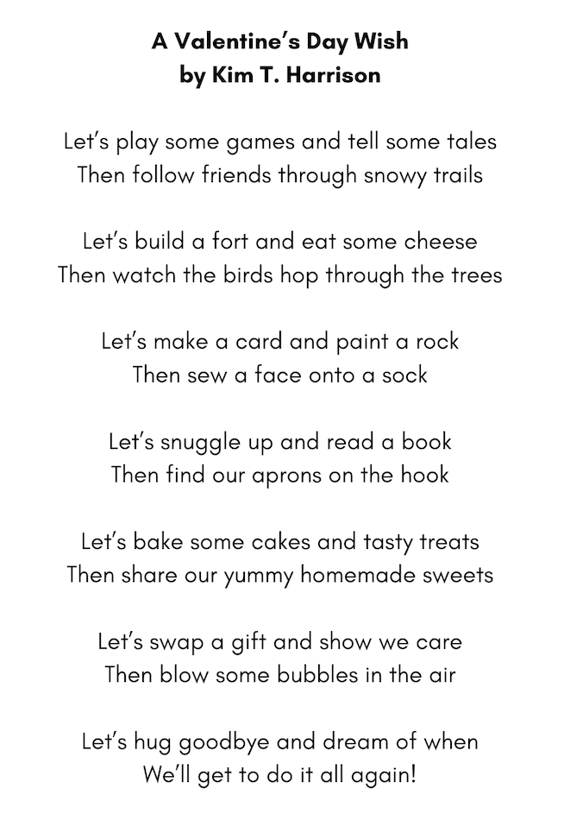
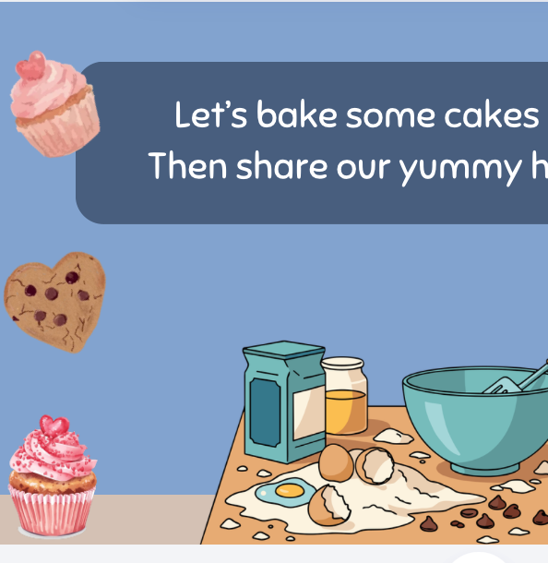
“A Valentine’s Day Wish”
POEM & ACTIVITIES
Grades K-2
ESL, ELL
Original poem by Kim T. Harrison

Slide 2
A Valentine’s Day Wish
Let’s play some games and tell some tales
Then follow friends through snowy trails
Let’s build a fort and eat some cheese
Then watch the birds hop through the trees
Let’s make a card and paint a rock
Then sew a face onto a sock
Let’s snuggle up and read a book
Then find our aprons on the hook
Let’s bake some cakes and tasty treats
Then share our yummy homemade sweets
Let’s swap a gift and show we care
Then blow some bubbles in the air
Let’s hug goodbye and dream of when
We’ll get to do it all again!

Slide 3
Can you…
Draw one of the activities featured in the poem
Paint a rock or make a card
List 5 activities you would like to do in a “perfect day” with your grandparent or other person you love spending time with
Act out the day you heard about in the poem
choose one activity you do with a grandparent or other family member and tell the class about it

Slide 4

MORE POEMS & ACTIVITIES…
Grab a print-ready, PDF version of the poem along with more teaching ideas and inspiration at KimTHarrison.ca – Teacher Resources
Browse other poems on a variety of curriculum-friendly topics on my website – KimTHarrison.ca – or my YouTube channel: https://www.youtube.com/@KimTHarrison/videos
Poetry Pause with Dr. Kim videos include a short interactive mindfulness introduction before a poem read by me, the poet! Poetry Time with Dr. Kim videos include the poem and a visual narrative.

Slide 5

THANK YOU & HAPPY POETRY TEACHING!
Copyright & Terms of Use
About Dr. Kim
Original poems or stories are copyright © Kim T. Harrison, 2026
Fonts credit: Google Fonts (Urbanist; Caveat)
Additional images and video creation: Canva Pro
You have permission to use this resource for educational purposes only.
Any re-selling is prohibited; similarly, re-sharing without attribution is prohibited.
If sharing this poem or story with other educators, please include link to my website: kimtharrison.ca and/or my full name, Kim T. Harrison
If you have questions, would like to provide feedback, or need a poem about a sleepy snail, please get in touch: kimtharrisonwrites@gmail.com
Dr. Kim’s full name is Kim T. Harrison. She is a writer, poet, and teacher, who was born in England but moved to Canada a long time ago and now lives on the beautiful island of Newfoundland.
Dr. Kim can’t help fix a broken leg or a sore throat, but she can prescribe poetry reading and writing activities! She’s a “doctor” because she has a PhD in French literature and cultural studies. This means she’s read and written about A LOT of books and poems. When she was a kid, her favourite book had lots of different poems in it. She still reads these poems today and now writes her own because she loves the sound and feel of words, and the magic that happens when those words work together to create new worlds.
Find out more at: KimTHarrison.ca

