Slide 1
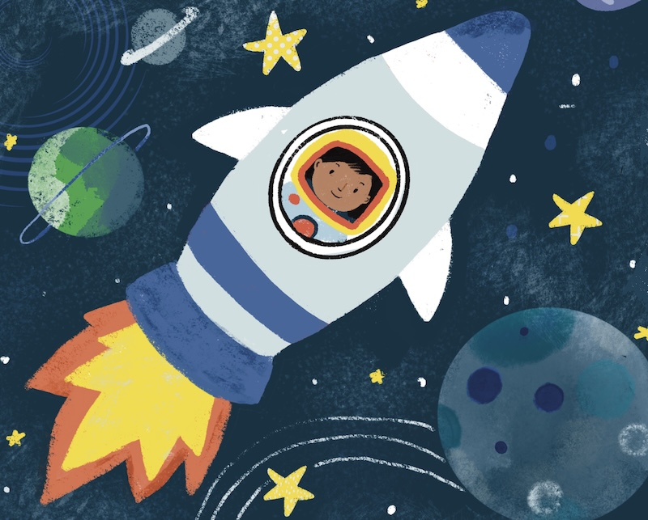
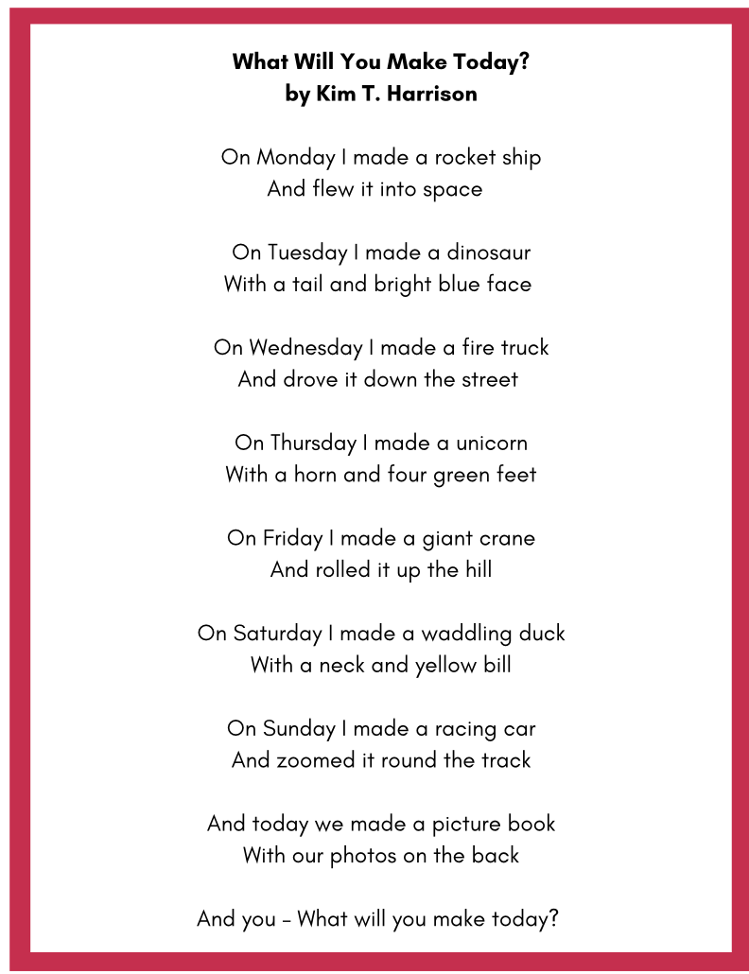
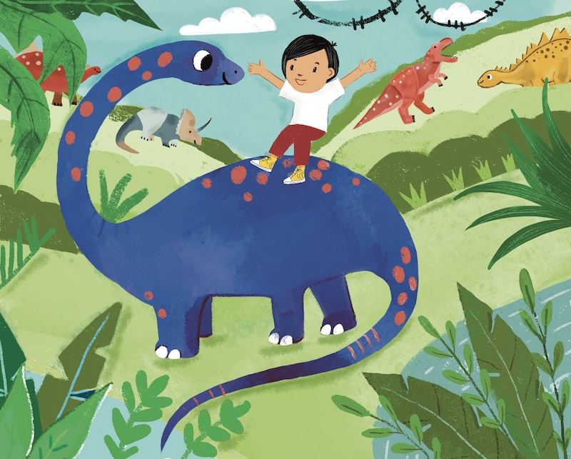
“What Will You Make Today?” POEM
Grades pre-K-K
ESL, ELL
Original poem by Kim T. Harrison
Art by Farida Zaman

Slide 2
On Monday I made a rocket ship
And flew it into space
On Tuesday I made a dinosaur
With a tail and bright blue face
On Wednesday I made a fire truck
And drove it down the street
On Thursday I made a unicorn
With a horn and four green feet
On Friday I made a giant crane
And rolled it up the hill
On Saturday I made a waddling duck
With a neck and yellow bill
On Sunday I made a racing car
And zoomed it round the track
And today we made a picture book
With our photos on the back
And you – What will you make today?

Slide 3
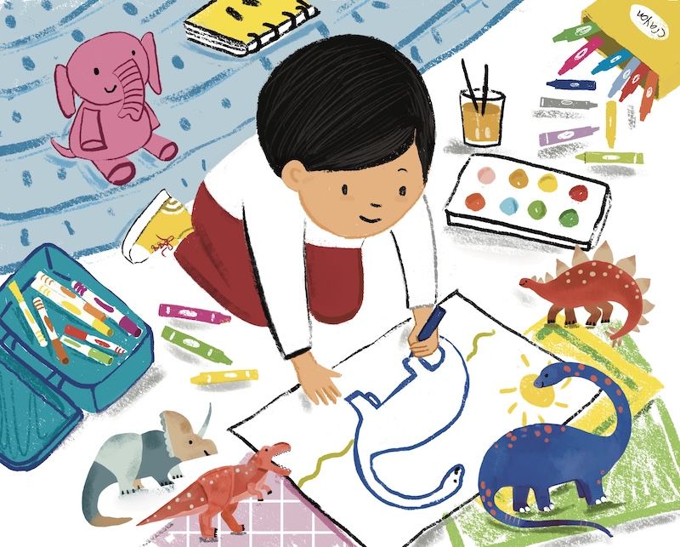


Slide 4

MORE POEMS & ACTIVITIES…
Grab a print-ready, PDF version of the poem along with more teaching ideas and inspiration at KimTHarrison.ca – Teacher Resources
Browse other poems on a variety of curriculum-friendly topics on my website – KimTHarrison.ca – or my YouTube channel: https://www.youtube.com/@KimTHarrison/videos
Poetry Pause with Dr. Kim videos include a short interactive mindfulness introduction before a poem read by me, the poet! Poetry Time with Dr. Kim videos include the poem and a visual narrative.

Slide 5

THANK YOU & HAPPY POETRY TEACHING!
Copyright & Terms of Use
About Dr. Kim
Original poems or stories are copyright © Kim T. Harrison, 2026
Fonts credit: Google Fonts (Urbanist; Caveat)
Additional images and video creation: Canva Pro
Art for “What Will You Make Today?” – © Farida Zaman, 2026
You have permission to use this resource for educational purposes only.
Any re-selling is prohibited; similarly, re-sharing without attribution is prohibited.
If sharing this poem or story with other educators, please include link to my website: kimtharrison.ca and/or my full name, Kim T. Harrison
If you have questions, would like to provide feedback, or need a poem about a sleepy snail, please get in touch: kimtharrisonwrites@gmail.com
Dr. Kim’s full name is Kim T. Harrison. She is a writer, poet, and teacher, who was born in England but moved to Canada a long time ago and now lives on the beautiful island of Newfoundland.
Dr. Kim can’t help fix a broken leg or a sore throat, but she can prescribe poetry reading and writing activities! She’s a “doctor” because she has a PhD in French literature and cultural studies. This means she’s read and written about A LOT of books and poems. When she was a kid, her favourite book had lots of different poems in it. She still reads these poems today and now writes her own because she loves the sound and feel of words, and the magic that happens when those words work together to create new worlds.
Find out more at: KimTHarrison.ca

