Slide 1
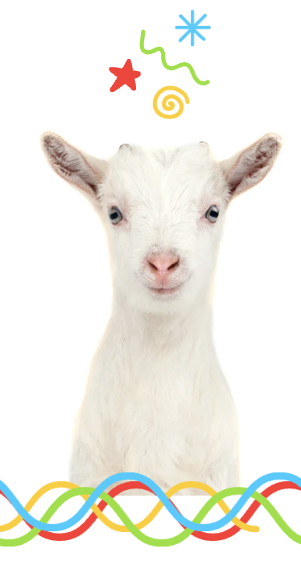
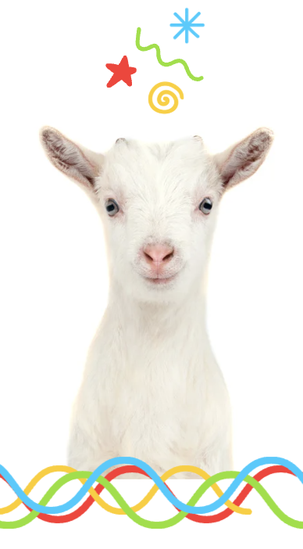
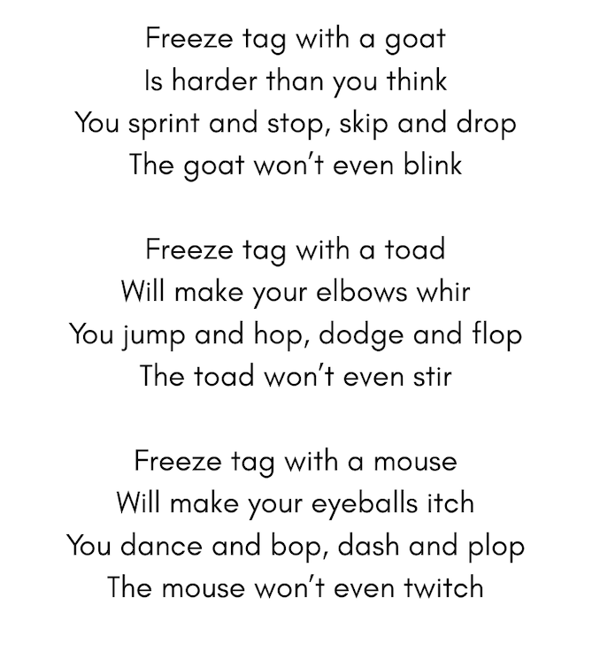
“FREEZE TAG WITH A GOAT” POEM
Grades 1-3
Original poem by Kim T. Harrison

Slide 2
Freeze Tag with a Goat
Freeze tag with a goat
Is harder than you think
You sprint and stop, skip and drop
The goat won’t even blink
Freeze tag with a toad
Will make your elbows whir
You jump and hop, dodge and flop
The toad won’t even stir
Freeze tag with a mouse
Will make your eyeballs itch
You dance and bop, dash and plop
The mouse won’t even twitch

Slide 3
Can you …
Act out the movements in the poem
Draw a scene from the poem

Slide 4
Inquiry Questions
What other animals freeze as a response to a threat?
How long do they stay frozen?
What do they do after the freeze response?
What other responses do animals have when they feel threatened?

Slide 5
Opinion Questions
Do you think freezing is a good response to a threat for animals? Why, why not?
If you were a goat, when do you think you would freeze?

Slide 6

MORE POEMS & ACTIVITIES…
Grab a print-ready, PDF version of the poem along with more teaching ideas and inspiration at KimTHarrison.ca – Teacher Resources
Browse other poems on a variety of curriculum-friendly topics on my website – KimTHarrison.ca – or my YouTube channel: https://www.youtube.com/@KimTHarrison/videos
Poetry Pause with Dr. Kim videos include a short interactive mindfulness introduction before a poem read by me, the poet! Poetry Time with Dr. Kim videos include the poem and a visual narrative.

Slide 7

THANK YOU & HAPPY POETRY TEACHING!
Copyright & Terms of Use
About Dr. Kim
Original poems or stories are copyright © Kim T. Harrison, 2026
Fonts credit: Google Fonts (Urbanist; Caveat)
Additional images and video creation: Canva Pro
You have permission to use this resource for educational purposes only.
Any re-selling is prohibited; similarly, re-sharing without attribution is prohibited.
If sharing this poem or story with other educators, please include link to my website: kimtharrison.ca and/or my full name, Kim T. Harrison
If you have questions, would like to provide feedback, or need a poem about a sleepy snail, please get in touch: kimtharrisonwrites@gmail.com
Dr. Kim’s full name is Kim T. Harrison. She is a writer, poet, and teacher, who was born in England but moved to Canada a long time ago and now lives on the beautiful island of Newfoundland.
Dr. Kim can’t help fix a broken leg or a sore throat, but she can prescribe poetry reading and writing activities! She’s a “doctor” because she has a PhD in French literature and cultural studies. This means she’s read and written about A LOT of books and poems. When she was a kid, her favourite book had lots of different poems in it. She still reads these poems today and now writes her own because she loves the sound and feel of words, and the magic that happens when those words work together to create new worlds.
Find out more at: KimTHarrison.ca

