Slide 1
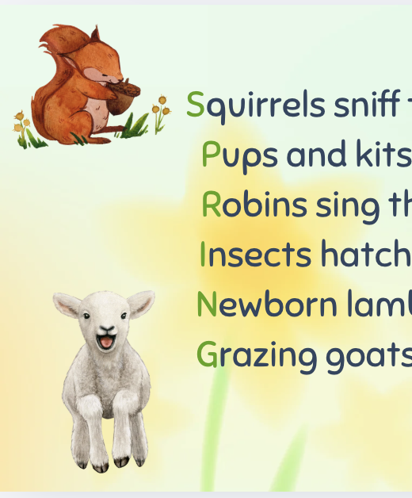
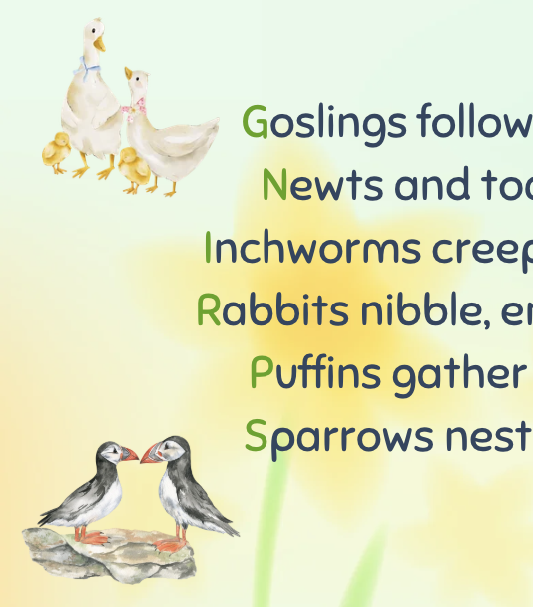
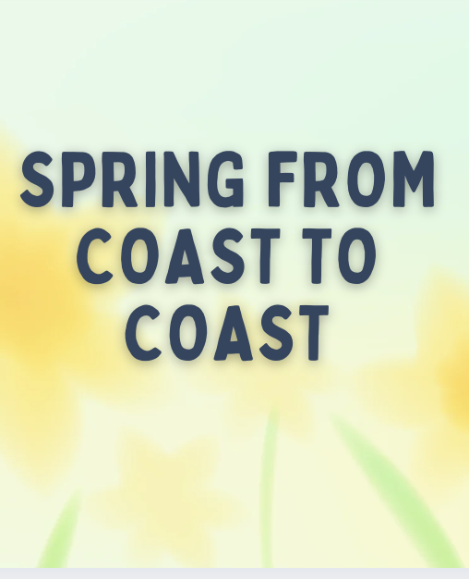
“Spring from Coast to Coast” POEM
Grades 2-3
ESL, ELL
Original poem by Kim T. Harrison

Slide 2
Teaching Ideas:
Introduce acrostic poems, then ask students to write their own acrostics using simple SPINE words (see next slide for sample)
Complement classes on spring animals – use inquiry questions to discover what the animals in the poem do during spring
Complement classes on different Canadian provinces – use inquiry questions or research to discover which animals live in which Canadian provinces
Fine arts activities – students draw a scene from the poem or draw a picture of an animal of their choosing in spring
Animals featured in the poem: squirrels, foxes, robins, insects, lambs, goats, goslings, newts, toads, inchworms, rabbits, puffins, sparrows

Slide 3
Can you write your own acrostic poem?
Choose a short word to be the SPINE of your poem. For example: DOG
Now, write D O G vertically on your page
Then write 3 lines. The first line will start with a D-word, the second line with an O-word, and the third with a G-word.
For example:
Digging in the dirt
Outside, my dog
Greets me with a happy bark

Slide 4

MORE POEMS & ACTIVITIES…
Grab a print-ready, PDF version of the poem along with more teaching ideas and inspiration at KimTHarrison.ca – Teacher Resources
Browse other poems on a variety of curriculum-friendly topics on my website – KimTHarrison.ca – or my YouTube channel: https://www.youtube.com/@KimTHarrison/videos
Poetry Pause with Dr. Kim videos include a short interactive mindfulness introduction before a poem read by me, the poet! Poetry Time with Dr. Kim videos include the poem and a visual narrative.

Slide 5

THANK YOU & HAPPY POETRY TEACHING!
Copyright & Terms of Use
About Dr. Kim
Original poems or stories are copyright © Kim T. Harrison, 2026
Fonts credit: Google Fonts (Urbanist; Caveat)
Additional images and video creation: Canva Pro
You have permission to use this resource for educational purposes only.
Any re-selling is prohibited; similarly, re-sharing without attribution is prohibited.
If sharing this poem or story with other educators, please include link to my website: kimtharrison.ca and/or my full name, Kim T. Harrison
If you have questions, would like to provide feedback, or need a poem about a sleepy snail, please get in touch: kimtharrisonwrites@gmail.com
Dr. Kim’s full name is Kim T. Harrison. She is a writer, poet, and teacher, who was born in England but moved to Canada a long time ago and now lives on the beautiful island of Newfoundland.
Dr. Kim can’t help fix a broken leg or a sore throat, but she can prescribe poetry reading and writing activities! She’s a “doctor” because she has a PhD in French literature and cultural studies. This means she’s read and written about A LOT of books and poems. When she was a kid, her favourite book had lots of different poems in it. She still reads these poems today and now writes her own because she loves the sound and feel of words, and the magic that happens when those words work together to create new worlds.
Find out more at: KimTHarrison.ca

