Slide 1
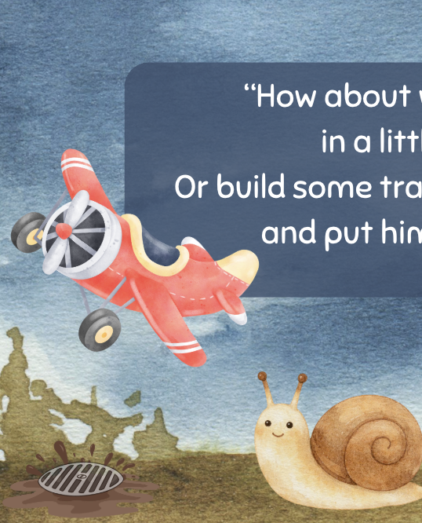
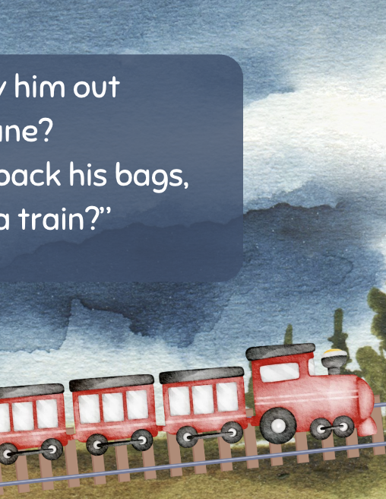
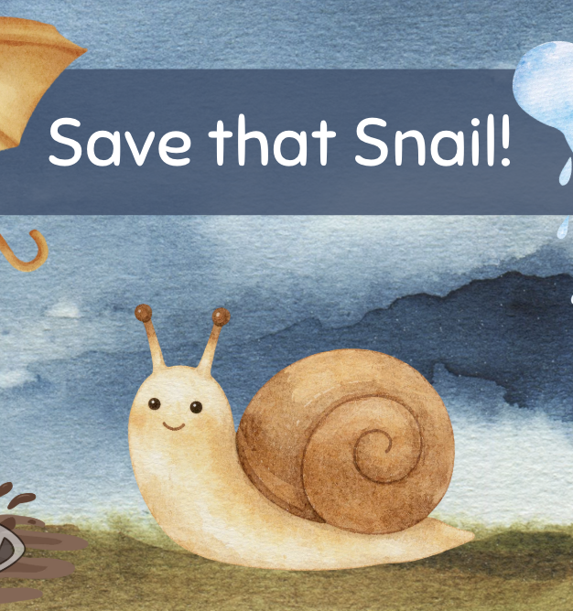
“Save that Snail!” Poem
& Activity Ideas
Grades K-2
ESL, ELL
Original poem by Kim T. Harrison

Slide 2
Save that Snail!
“Look,” Jack said, “that snail might fall
into the muddy drain.
How can we help get him home
before it starts to rain?”
“What if,” Sam said, “we move him
with a tiny crane?
Or roll his shell on a bridge,
made from a daisy chain?”
“How about we fly him out
in a little plane?
Or build some tracks, pack his bags,
and put him on a train?”
“But,” Sam said, “we don’t want him
to feel any pain.
Let’s place him down, on those leaves,
until he’s safe again.”

Slide 3
Teaching Ideas:
Visualization: Read the poem aloud for your students or play the YouTube video without visual and ask students to draw one or more of the scenes or images from the poem.
Creativity and construction: Students could make one or more of the ideas to save the snail out of blocks, card, or other classroom materials.
Poetry writing: Students can create their own poem or story by changing the animal in the title. (For example, Save that Frog! Or Save that Worm!)
Opinion questions: Is it a good idea to move a snail from the road to leaves? Do you sometimes try to save snails or other animals? Why or why not?
Creativity and imagination: How would you save a snail? What other things could you make a snail bridge from? How would you make a train for snails?
Environmental awareness & responsibility: Students can research or discover different types of snails and identify what the snail in the poem might be. You can ask students to think about why we might need to save some animals and what we can do to save them. You could also ask students about animals we shouldn’t approach or try to help, and what we can do if we see such an animal in need of help.

Slide 4

MORE POEMS & ACTIVITIES…
Grab a print-ready, PDF version of the poem along with more teaching ideas and inspiration at KimTHarrison.ca – Teacher Resources
Browse other poems on a variety of curriculum-friendly topics on my website – KimTHarrison.ca – or my YouTube channel: https://www.youtube.com/@KimTHarrison/videos
Poetry Pause with Dr. Kim videos include a short interactive mindfulness introduction before a poem read by me, the poet! Poetry Time with Dr. Kim videos include the poem and a visual narrative.

Slide 5

THANK YOU & HAPPY POETRY TEACHING!
Copyright & Terms of Use
About Dr. Kim
Original poems or stories are copyright © Kim T. Harrison, 2026
Fonts credit: Google Fonts (Urbanist; Caveat)
Additional images and video creation: Canva Pro
You have permission to use this resource for educational purposes only.
Any re-selling is prohibited; similarly, re-sharing without attribution is prohibited.
If sharing this poem or story with other educators, please include link to my website: kimtharrison.ca and/or my full name, Kim T. Harrison
If you have questions, would like to provide feedback, or need a poem about a sleepy snail, please get in touch: kimtharrisonwrites@gmail.com
Dr. Kim’s full name is Kim T. Harrison. She is a writer, poet, and teacher, who was born in England but moved to Canada a long time ago and now lives on the beautiful island of Newfoundland.
Dr. Kim can’t help fix a broken leg or a sore throat, but she can prescribe poetry reading and writing activities! She’s a “doctor” because she has a PhD in French literature and cultural studies. This means she’s read and written about A LOT of books and poems. When she was a kid, her favourite book had lots of different poems in it. She still reads these poems today and now writes her own because she loves the sound and feel of words, and the magic that happens when those words work together to create new worlds.
Find out more at: KimTHarrison.ca

