Slide 1
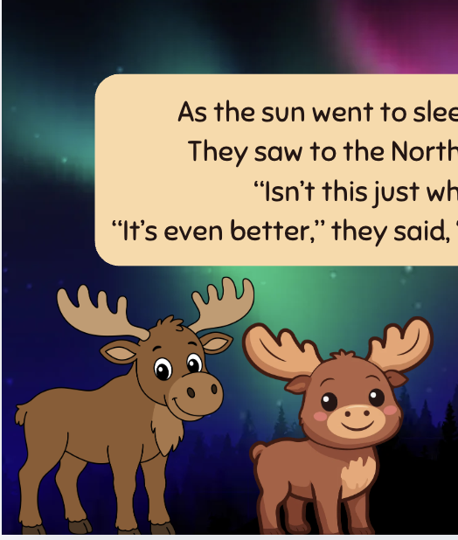
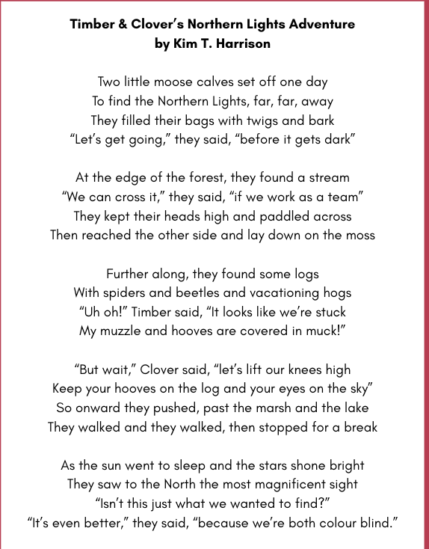
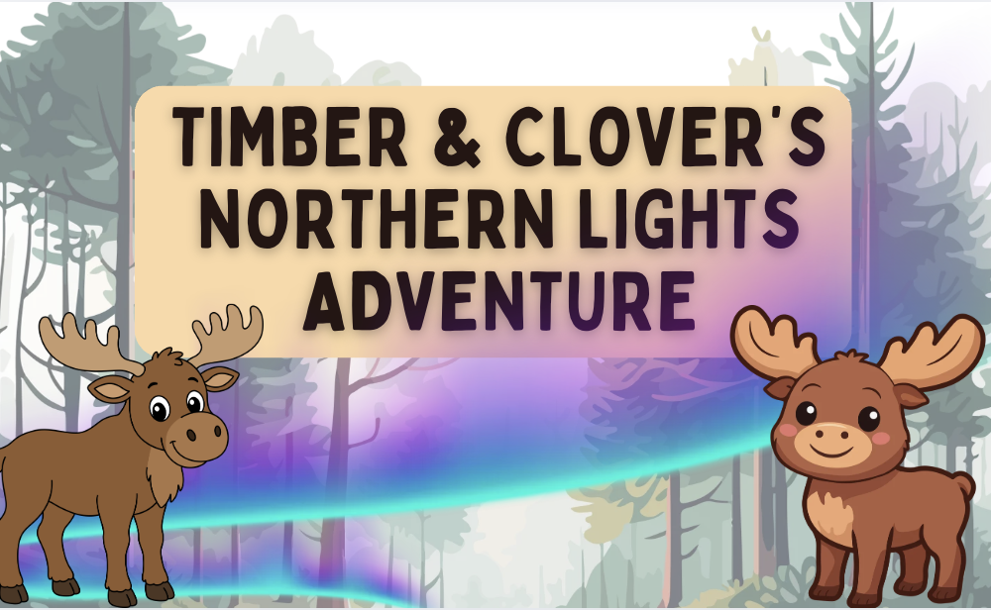
“Clover & Timber’s Northern Lights Adventure” POEM
Grades 1-3
Original poem by Kim T. Harrison

Slide 2
Clover & Timber’s Northern Lights Adventure
Two little moose calves set off one day
To find the Northern Lights, far, far, away
They filled their bags with twigs and bark
“Let’s get going,” they said, “before it gets dark”
At the edge of the forest, they found a stream
“We can cross it,” they said, “if we work as a team”
They kept their heads high and paddled across
Then reached the other side and lay down on the moss
Further along, they found some logs
With spiders and beetles and vacationing hogs
“Uh oh!” Timber said, “It looks like we’re stuck
My muzzle and hooves are covered in muck!”
“But wait,” Clover said, “let’s lift our knees high
Keep your hooves on the log and your eyes on the sky”
So onward they pushed, past the marsh and the lake
They walked and they walked, then stopped for a break
As the sun went to sleep and the stars shone bright
They saw to the North the most magnificent sight
“Isn’t this just what we wanted to find?”
“It’s even better,” they said, “because we’re both colour blind.”

Slide 3
Inquiry Questions
What are the moose doing in this poem?
Can they do that in real life?
What else can moose do? What can’t they do?
Where do moose live in Canada?

Slide 4
Sharing Stories & Opinion Questions
Have you ever seen the northern lights?
Have you ever seen a moose?
Would you like to? Why / Why not?

Slide 5
Critical Thinking & Response Questions
Why do Clover and Timber say “It’s even better” in the poem.
How could seeing the northern lights be even better for the moose?
Could being colour blind be an advantage?

Slide 6
Creative Writing
Imagine Clover & Timber are setting out on a new adventure.
Where would they go?
What do they want to see or experience now?

Slide 7
Other teaching ideas
Use the poem “Timber & Clover’s Northern Lights Adventure” in various ways:
As a bell ringer or post-recess moment of focus. Let the video play while you tidy or prep.
Introduce or complement classes on animal habitat or behaviours: use inquiry questions inspired by the events in the poem to discover what moose can and cannot do, where moose live in Canada, and what kinds of habitats they prefer
Discuss colour blindness in humans and animals (teacher note: moose are considered to be colour blind. See this article by Paul Smith for more information: https://www.saltwire.com/newfoundland-labrador/paul-smith-moose-are-colour-blind-164355)
Use inquiry questions to discover more information about the northern lights, including where in Canada they can be seen from
Sharing stories and opinions: ask students if they have ever seen the northern lights or if they’d like to.
Critical thinking and response: ask students why Clover and Timber say “It’s even better” in the poem. How could seeing the northern lights be even better for the moose? Could being colour blind be an advantage?
Poetry reading and performance: use the poem as a reading out loud or performance text
Creativity and art: ask students to illustrate the poem. They could choose one scene or could work together to illustrate the full poem
Creative writing: ask students to imagine Clover & Timber setting out on a new adventure. Where would they go? What do they want to see or experience now? Students can say or write their new adventure story in poetic form or prose

Slide 8
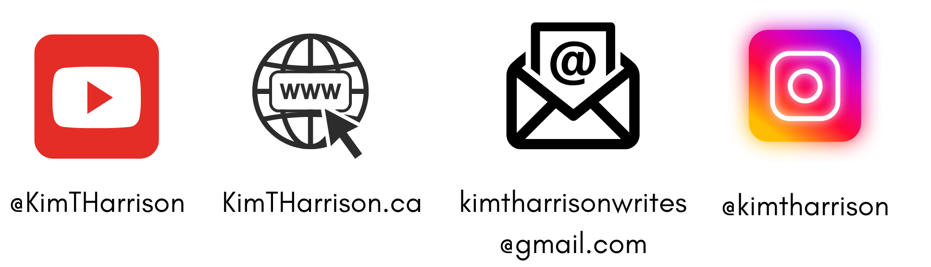
MORE POEMS & ACTIVITIES…
Grab a print-ready, PDF version of the poem along with more teaching ideas and inspiration at KimTHarrison.ca – Teacher Resources
Browse other poems on a variety of curriculum-friendly topics on my website – KimTHarrison.ca – or my YouTube channel: https://www.youtube.com/@KimTHarrison/videos
Poetry Pause with Dr. Kim videos include a short interactive mindfulness introduction before a poem read by me, the poet! Poetry Time with Dr. Kim videos include the poem and a visual narrative.

Slide 9
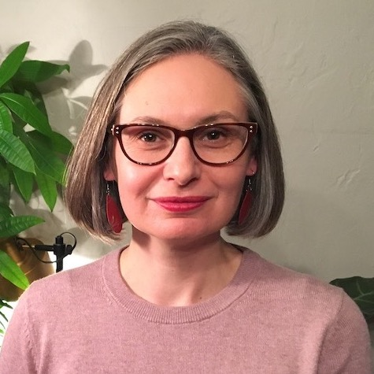
THANK YOU & HAPPY POETRY TEACHING!
Copyright & Terms of Use
About Dr. Kim
Original poems or stories are copyright © Kim T. Harrison, 2026
Fonts credit: Google Fonts (Urbanist; Caveat)
Additional images and video creation: Canva Pro
You have permission to use this resource for educational purposes only.
Any re-selling is prohibited; similarly, re-sharing without attribution is prohibited.
If sharing this poem or story with other educators, please include link to my website: kimtharrison.ca and/or my full name, Kim T. Harrison
If you have questions, would like to provide feedback, or need a poem about a sleepy snail, please get in touch: kimtharrisonwrites@gmail.com
Dr. Kim’s full name is Kim T. Harrison. She is a writer, poet, and teacher, who was born in England but moved to Canada a long time ago and now lives on the beautiful island of Newfoundland.
Dr. Kim can’t help fix a broken leg or a sore throat, but she can prescribe poetry reading and writing activities! She’s a “doctor” because she has a PhD in French literature and cultural studies. This means she’s read and written about A LOT of books and poems. When she was a kid, her favourite book had lots of different poems in it. She still reads these poems today and now writes her own because she loves the sound and feel of words, and the magic that happens when those words work together to create new worlds.
Find out more at: KimTHarrison.ca

