Slide 1
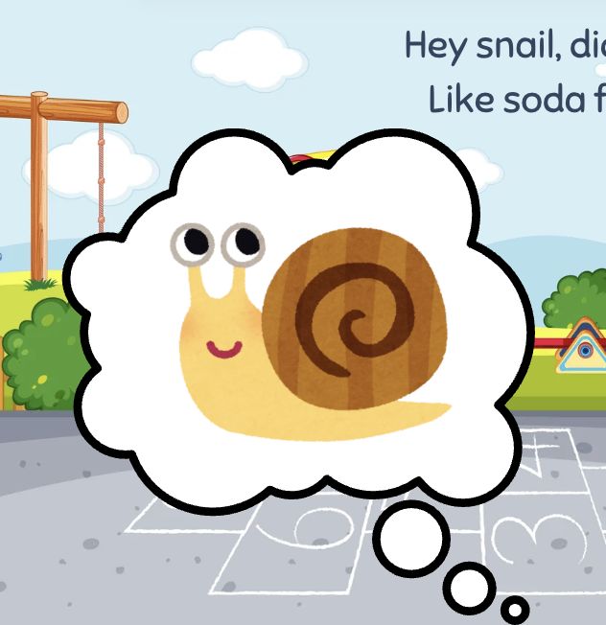
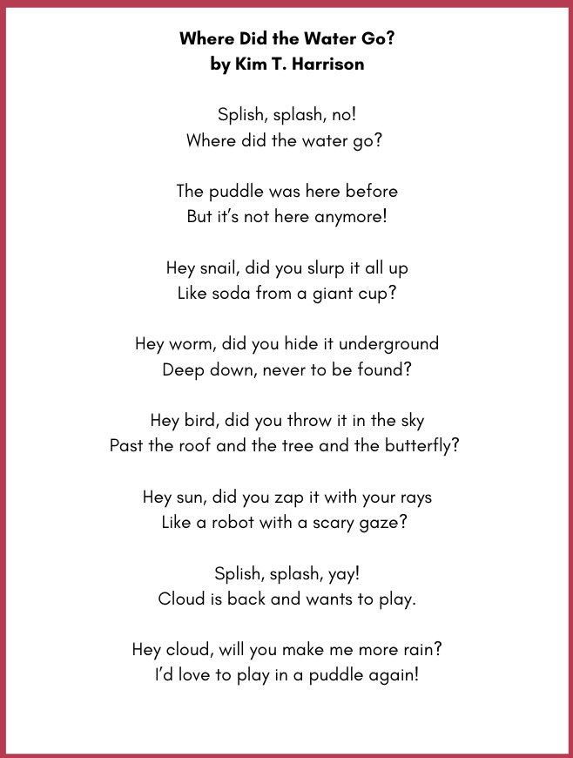
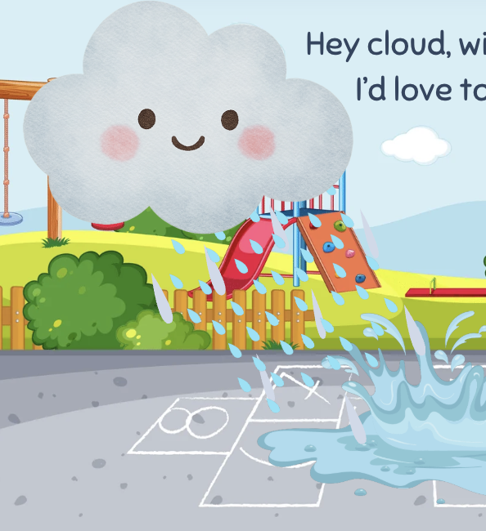
“Where Did the Water Go?”
POEM
Grade 2
Original poem by Kim T. Harrison

Slide 2
Splish, splash, no!
Where did the water go?
The puddle was here before
But it’s not here anymore!
Hey snail, did you slurp it all up
Like soda from a giant cup?
Hey worm, did you hide it underground
Deep down, never to be found?
Hey bird, did you throw it in the sky
Past the roof and the tree and the butterfly?
Hey sun, did you zap it with your rays
Like a robot with a scary gaze?
Splish, splash, yay!
Cloud is back and wants to play.
Hey cloud, will you make me more rain?
I’d love to play in a puddle again!

Slide 3
Where did the water go in your opinion?
Can snails make water disappear? How?
Can a worm hide water underground? How can it take water underground?
How could a bird throw water into the sky?
How can the sun zap water with its rays?
How does a cloud make rain?

Slide 4

MORE POEMS & ACTIVITIES…
Grab a print-ready, PDF version of the poem along with more teaching ideas and inspiration at KimTHarrison.ca – Teacher Resources
Browse other poems on a variety of curriculum-friendly topics on my website – KimTHarrison.ca – or my YouTube channel: https://www.youtube.com/@KimTHarrison/videos
Poetry Pause with Dr. Kim videos include a short interactive mindfulness introduction before a poem read by me, the poet! Poetry Time with Dr. Kim videos include the poem and a visual narrative.

Slide 5

THANK YOU & HAPPY POETRY TEACHING!
Copyright & Terms of Use
About Dr. Kim
Original poems or stories are copyright © Kim T. Harrison, 2026
Fonts credit: Google Fonts (Urbanist; Caveat)
Additional images and video creation: Canva Pro
You have permission to use this resource for educational purposes only.
Any re-selling is prohibited; similarly, re-sharing without attribution is prohibited.
If sharing this poem or story with other educators, please include link to my website: kimtharrison.ca and/or my full name, Kim T. Harrison
If you have questions, would like to provide feedback, or need a poem about a sleepy snail, please get in touch: kimtharrisonwrites@gmail.com
Dr. Kim’s full name is Kim T. Harrison. She is a writer, poet, and teacher, who was born in England but moved to Canada a long time ago and now lives on the beautiful island of Newfoundland.
Dr. Kim can’t help fix a broken leg or a sore throat, but she can prescribe poetry reading and writing activities! She’s a “doctor” because she has a PhD in French literature and cultural studies. This means she’s read and written about A LOT of books and poems. When she was a kid, her favourite book had lots of different poems in it. She still reads these poems today and now writes her own because she loves the sound and feel of words, and the magic that happens when those words work together to create new worlds.
Find out more at: KimTHarrison.ca

